Slide 1
Little Angus, your eyes are haunting me:
Emotion and ethics in the NZ alternative meat market
Matthew J. Hale, Meike Rombach, Lynne Robertson & David L. Dean
Christchurch, New Zealand, 28/08/26
1
Notes:
Good morning, and thank you for the opportunity to present today. Our paper is titled 'Little Angus, your eyes are haunting me.' Over the next twelve minutes or so, I'll explain exactly where that title comes from.
This is joint work with Meike Rombach and David Dean at Lincoln University. What we set out to understand is how plant- and fungal-based meat is advertised in New Zealand. In particular, how those advertisements use emotion and ethics to persuade us.

Slide 2
Introduction
Plant & fungal-
based meats
NZ market situation
93% omnivores
Retail revenue
Consumers &
Demand
Young Consumers
Climate Consciousness
Health
Price Premium
Limited Product Assortments
Niche
Consumer behaviour
Research Gap
Emotion & Ethics
Advertisements shape behaviour
Source: Statista (2025); Goode et al. (2025); Dean et al. (2024); Greenwell et al. (2024); Kidd et al.(2021); White et al. (2021)
2
Notes:
Let me set the scene. Meat is central to the New Zealand diet. Around 93% of us are omnivores. Only a small minority eat vegan, vegetarian, or reduced-meat diets - although that group is slowly growing, led mostly by younger consumers. That makes plant- and fungal-based meat a niche product that is still trying to find its place in a country that loves the real thing. Plant and fungal based meats are marketed as lifestyle products that come at a high price point, the shelf range is limited, and retail sales sit at only 30 to 45 million dollars a year.
This is where emotion and ethics come in. For a product like this, ethics adds to its usefulness, its utility, beyond how it tastes or performs. For these buyers, the ethics are not a side issue. Choosing a plant- or fungal-based product is a way to act on their values, to spare an animal and tread more lightly on the planet, and that is part of what they are paying for. Emotion shapes how the brand connects with the person the consumer wants to be. Put those together, and they reframe a higher price as an investment in themselves.
Research so far has focused on acceptance, on willingness to pay, and on word of mouth. It has paid very little attention to the advertising itself, and to how its emotional and ethical content shapes our choices. That is the gap this study sets out to address.

Slide 3
Aim & Objectives
AIM
To analyse how emotion and ethics are presented in, and shape the content of, plant- and fungal-based meat advertisements in New Zealand.
OBJECTIVE 1
Explore how the schools of normative ethics, virtue, utilitarian and deontology, are presented in plant- and fungal-based meat advertisements.
OBJECTIVE 2
Explore how emotion and cognitive dissonance (the meat paradox) are presented in, and shape the content of, those advertisements.
3
Notes:
Our aim is to analyse how emotion and ethics are presented in plant and fungal based meat advertisements in New Zealand AND how they shape what those advertisements show.
Two objectives are aligned with this aim. The first looks at schools of ethics and how they show up in these ads. The second looks at how emotion and cognitive dissonance, what we call the meat paradox, are presented, and how they shape the content.

Slide 4
Literature review
Emotion associated with plant & fungal based meat consumption
(Markowski & Roxburgh, 2019; Onwezen et al., 2022; Zandstra et al., 2024)
In advertisements and marketing messages → emotional appeals
(Wang et al., 2024; Ye & Mattila, 2021)
Meat paradox, defence mechanism and emotion
(Buttlar & Walther, 2018; Gradidge et al., 2021; Fonseca & De Groeve, 2025)
Vegan ethics → virtue, utilitarianism and deontology
(Alvaro, 2017)
Strong ethical messages do not always resonate with consumers with varying meat eating preferences
(Chaput & Paulsson, 2023; Yue, 2023)
4
Notes:
To read those advertisements, we lean on three ideas.
The first is emotion. Plant-based eating once carried a stigma, and the feelings around it were mostly negative. That has now flipped. It is tied to positive emotions instead: pride, hope, a sense of being progressive. Advertisers turn those feelings into emotional appeals.
The second idea is the meat paradox. Most of us care about animals. And yet most of us eat them. That contradiction creates a real discomfort, what psychologists call cognitive dissonance. It also stirs up different emotions, depending on whether we focus on the animal as a victim, on ourselves as the perpetrator, or on our own feelings. We tend to resolve that discomfort with a few coping moves. The best known are the four Ns: that eating meat is natural, normal, necessary, and nice.
The third idea is ethics. Here there are three schools of thought: virtue, utilitarian, and deontological. And this is where the key tension sits. We already know that strong ethical or shaming messages tend to alienate omnivores. So there is a real pull between making a moral point and keeping everyone on side. What is new in our work is bringing vegan ethics into the reading of the advertising itself. So those are the three ideas. Now let's see how they play out in the real ads.

Slide 5


Material and Methods
Ethics
Emotion
Meat paradox
Alternative meats
35 video ads
From Beyond Meat, La Vie, Impossible Burgers, Sunfed Meats and Quorn.
Video clips transcribed and analyzed through qualitative content analysis using an abductive approach
Excel spreadsheet and NVivo used for QCA
Source: Elo & Kyngäs (2008)
5
Notes:
A quick word on how we did this, because the method matters. The study is exploratory and qualitative. It helps to be clear about what that means. We are not setting out to confirm or test a theory. We are not chasing statistical representativeness. Qualitative work like this aims for richness and depth. It captures the variability and texture of the material AND it does that through purposeful sampling AND choosing cases because they are revealing.
In concrete terms, we examined thirty-five video advertisements. They ran in New Zealand and Australia. We treat those two markets together, because they share the same retail chains, brands, and products. The ads came from five brands: Beyond Meat, La Vie, Impossible Burgers, Sunfed Meats, and Quorn. We transcribed every one, and analysed them using qualitative content analysis, working in an abductive way. That simply means we let the themes emerge from the material first. Then we interpreted them through our three lenses: ethics, the meat paradox, and emotion. We managed the whole analysis in Excel and NVivo. So, with the method clear, let me turn to what we found.

Slide 6
Results and Discussion
6
Notes:
So, what did we find? Across the thirty-five advertisements, two broad approaches stood out. The first plays it safe and keeps the focus firmly on the product. The second is far bolder, and it walks straight into the meat paradox. Let me take them one at a time.

Slide 7


Figure 1 +2: Social media outlets where chefs, celebrities and influencers share their content
Source: Meta (2026)
Ads feature well known chefs, celebrities or other opinion leader endorsing plant-based diets and products.
Focus: Product features, such as taste and texture, brands, humorous, modern, upbeat and positive in emotional display.
Polarising and controversial content are not presented.
Results consistent with the recent body of literature (Yule & Cummings, 2023; Chaput & Paulsson, 2025).
7
Notes:
The first approach is the conservative one, and it is everywhere. Many of these ads lean on a well-known chef, a celebrity, or an influencer who endorses a plant-based diet. The message arrives through a familiar, trusted face. And that face works as a kind of credibility signal.
The content stays firmly on the product, on its taste and texture. The tone is light, modern, and upbeat. And importantly, these ads avoid anything that might divide the audience. There is no guilt, and no confrontation. That fits what the literature predicts. “Focus on taste, function, and health, and you appeal to everyone” … to the committed meat eater and the curious meat reducer alike. But a second group of brands does the complete opposite. And that is where it gets interesting.

Slide 8
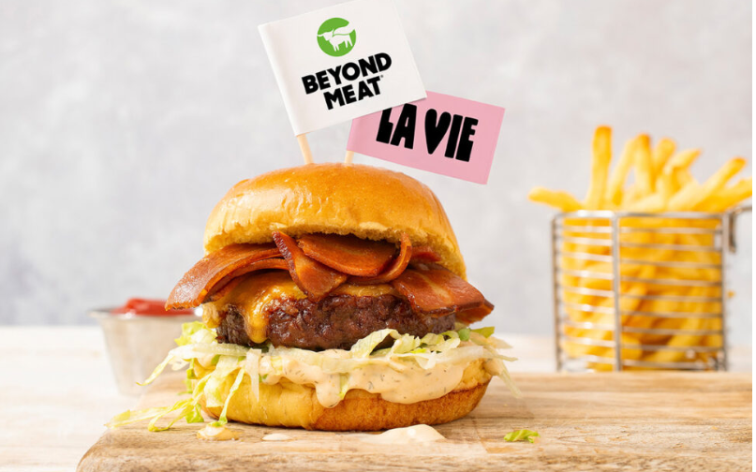
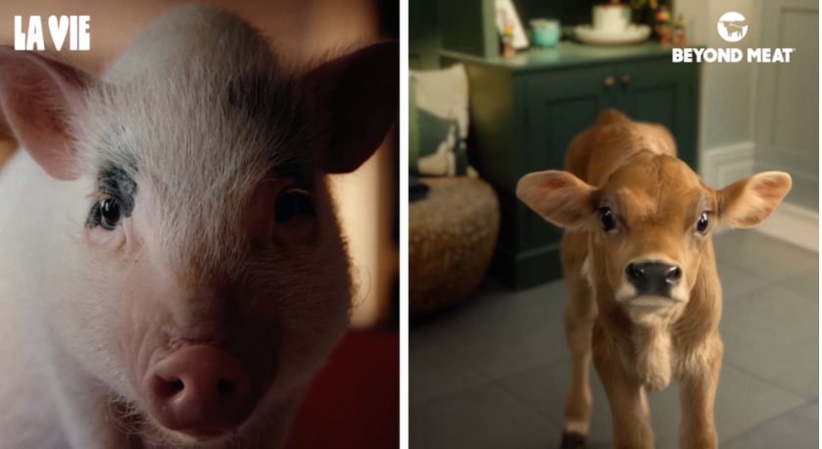
Ads do not allow consumers to separate the meat on their plate from a cute living piglet → Address meat paradox
Ads aligned with virtue ethics (Alvaro, 2017)
  Forces consumer to rethink their consumption habits by confronting them with the living animal and their intelligence.
  Evaluation is painful and a part of character-building towards altruism and compassion
  Plant-based meats are choice beyond product switching, it is the only right and virtuous choice from a vegan ethics perspective.
Emotional tension resolved towards nudge towards positivity
La Vie’s The meat is dead campaign was the blue print for Beyond meat’s “All taste and no worry”- campaign
Figure 3 +4: Ads with real animals Source: Vegan economist (2025))
8
Notes:
The second approach confronts the meat paradox head-on. Brands like Quorn, La Vie, and Beyond Meat deliberately put animals on screen, right alongside the meat that comes from them. The animals watch while the food is cooked and eaten. The music quietly builds. And the tension holds, until the moment it is revealed that the product is plant-based.
And these are always young animals like calves, chicks, and piglets. They are drawn as gentle, computer-generated characters, with childlike faces and big, anxious eyes. That, at last, is where our title comes from. Little Angus is one of those animals. And once you have seen those eyes, they really are hard to forget.
In Beyond Meat's advertisement, Little Angus is seen staring up at the consumer as the man takes the first bite of a loaded burger. Out of the corner of his eye the man catches a glimpse of the young calf with music playing titled “How could you do this to me?” In that moment, the animal stops being an abstraction. It becomes a character with feeling. And the plant-based product is offered as the way to resolve your discomfort. This is virtue ethics in action. The ad invites you to rethink your habits, and the brand presents itself as honest and accountable. This approach actually began with La Vie's piglet at the dinner table, the blueprint that Beyond Meat then followed. But notice the tone. Even here, it stays gentle. There is no shaming. It opens a door, rather than closing one.

Slide 9
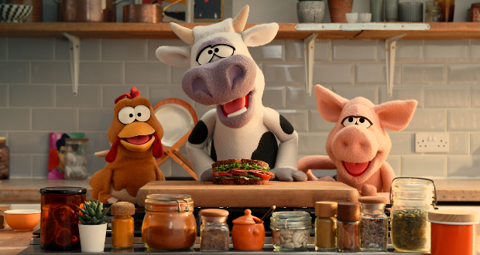
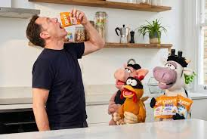
Ads use cartoon figures and hand puppets for their advertisements.
The whimsical and funny hand puppet animals bypass the meat paradox and emotional tension.
The concept rather builds on positive reinforcement and emotional shielding
Quorn advertisements are aligned with the utilitarian school of ethics.
  Utilitarianism seeks to create the greatest good for the greatest number of people and minimize harm.
  Without moral judgement and evaluative force, success towards consumer switching and reduction of animal cruelty greater success
Quorn’s “Don’t eat us”- Campaign
Figure 5 +6: Ads with cartoon animals Source: Quorn (2026))
9
Notes:
Quorn takes a different route again, in its 'Don't eat us' campaign. Here the focus falls on how tasty the fungal-based product is. And it is delivered through cartoon figures and hand puppets. That playfulness is deliberate. Those whimsical characters let the ad sidestep the meat paradox almost entirely. Rather than confronting the realities of farming and slaughter, it uses humour and warmth to shield the viewer. All while keeping the attention on the product.
In ethical terms, this is the utilitarian school at work. The goal is to normalise the product. To have it mimic the real thing closely enough that no one rejects it. And to nudge people toward switching of their own accord, for the wider good. And one pattern held right across all thirty-five ads. Not one of them relied on guilt, on blame, or on victimhood. Whenever tension appeared, it was quickly steered back to something positive. So what does all of this mean for marketers?

Slide 10
Conclusion
Study of merit as it brings together ethics, the meat paradox and emotion to analyse content of plant based meat advertisement→ Complement to various word mining studies
Relevance for food marketers and targeting varying meat eating preferences. Attention towards ethical appeals and imagery required as it feeds into meat paradox, if brands wish to serve also omnivorous consumers
Limitation: Transferability of results
Future research: Choice experiments to elicit consumer preferences for ethical messaging.
10
Notes:
Let me bring this together. The contribution of our work is that it brings together ethics, emotion, and the meat paradox to read what the advertising is really doing, and it adds vegan ethics to that toolkit. What emerges is a clear split in how brands handle the paradox. Some, like Quorn, shield us from it with humour. Others, like La Vie and Beyond Meat, confront it gently and let us resolve it for ourselves. Either way, the discomfort gets resolved rather than left hanging. And it is telling which ethics actually showed up. The ads leaned on virtue and on utilitarian thinking, but never on a hard, rights-based line, which tends to divide an audience rather than bring it along.
For marketers and producers, the message is to fit the approach to the audience. Lead with taste, enjoyment, and positivity to stay broad, and handle ethical content gently for omnivores, where confrontation costs you people. For those already committed to plant-based eating, you can afford to be far more explicit.
There are limits, of course. This sample is modest, and we are careful not to over-generalise. And the natural next step is choice experiments, to test how consumers actually respond to different ethical messaging.

Slide 11
References
Alvaro, C. (2017). Ethical veganism, virtue, and greatness of the soul. Journal of Agricultural and Environmental Ethics, 30(6), 765–781. https://doi.org/10.1007/s10806-017-9698-z
Buttlar, B., & Walther, E. (2018). Measuring the meat paradox: How ambivalence towards meat influences moral disengagement. Appetite, 128, 152–158. https://doi.org/10.1016/j.appet.2018.06.011
Chaput, M., & Paulsson, A. (2025). Tasting the alternative: plant-based meat, consumer captivation and the capitalization of plants in food markets. Consumption Markets & Culture, 28(5), 412–429. https://doi.org/10.1080/10253866.2025.2607368
Elo, S., & Kyngäs, H. (2008). The qualitative content analysis process. Journal of Advanced Nursing, 62(1), 107-115
Fonseca, R. P., & De Groeve, B. (2025). Meating ‘the animal and moral emotions: Exploring animal caring and cruelty appeals for dietary change. Appetite, 212, 108018.
Goode, J. P., Marchese, L. E., & Smith, K. J. (2025). Plant-based diets and health outcomes in Australia and New Zealand. Proceedings of the Nutrition Society, 84(2), 129–138. https://doi:10.1017/S0029665125001685
Gradidge, S., Zawisza, M., Harvey, A. J., & McDermott, D. T. (2021). A structured literature review of the meat paradox. Social Psychological Bulletin, 16(3), 1-26. https://doi.org/10.32872/spb.5953
Greenwell, J., Grant, M., Young, L., Mackay, S., & Bradbury, K. E. (2024). The prevalence of vegetarians, vegans and other dietary patterns that exclude some animal-source foods in a representative sample of New Zealand adults. Public Health Nutrition, 27(1), 1-9. https://doi:10.1017/S1368980023002677
Kidd, B., Mackay, S., Vandevijvere, S., & Swinburn, B. (2021). Cost and greenhouse gas emissions of current, healthy, flexitarian and vegan diets in Aotearoa (New Zealand). BMJ Nutrition, Prevention & Health, 4(1), 275-284. https://doi: 10.1136/bmjnph-2021-000262.
Markowski, K. L., & Roxburgh, S. (2019). “If I became a vegan, my family and friends would hate me:” Anticipating vegan stigma as a barrier to plant-based diets. Appetite, 135, 1–9. https://doi.org/10.1016/j.appet.2018.12.040
Onwezen, M. C., Verain, M. C. D., & Dagevos, H. (2022). Positive emotions explain increased intention to consume five types of alternative proteins. Food Quality and Preference, 96, 1-12. https://doi.org/10.1016/j.foodqual.2021.104446
Statista (2025). Meat Substitutes - New Zealand. Online available at https://www.statista.com/outlook/cmo/food/meat/meat-substitutes/new-zealand?srsltid=AfmBOop5OoaMbgTUcLV_pkva7vA5xxPtknRCZXpK9K5wIOxWB3-foUw4#revenue {Accessed 15/06/2026].
Wang, L., Li, W., & Zheng, Y. (2024). Does the advertising of plant‐based burgers attract meat consumers? The influence of new product advertising on consumer responses. Agribusiness, 40(3), 680-698. https://doi.org/10.1002/agr.21916
White, S. K., Ballantine, P. W., & Ozanne, L. K. (2022). Consumer adoption of plant-based meat substitutes: A network of social practices. Appetite, 175, 1-10. https://doi: 10.1016/j.appet.2022.106037
Ye, T., & Mattila, A. S. (2021). The effect of ad appeals and message framing on consumer responses to plant-based menu items. International Journal of Hospitality Management, 95, 1-9. https://doi.org/10.1016/j.ijhm.2021.102917
Yue, J. (2023). How downplaying green benefits could boost plant-based meat. Online available at https://impact.ed.ac.uk/research/climate-environmental-crisis/downplaying-green-boost-plant-based-meat/ [Accessed 16/06/26]
Zandstra, E. H., Ossel, L., & Neufingerl, N. (2024). Eating a plant-based burger makes me feel proud and cool: An online survey on food-evoked emotions of plant-based meat. Food Quality and Preference, 113, 1-7. https://doi.org/10.1016/j.foodqual.2023.105046
11
Notes:
Say nothing

Slide 12
12
Notes:
So that is our research of Little Angus and his big anxious eyes. The thought I would like to leave you with is this. What these advertisements really trade in is feeling. The most effective ones do not argue with us, and they do not shame us.
Thank you very much and I would be very glad to take any questions.

