Slide 1
Kiwi Flavour meets Silver Favour? Understanding predictors of older German consumers’ willingness to eat and pay a price premium for food produced in Aotearoa-New Zealand
Meike Rombach, Meike Guenther, Paul Rutherford & David L. Dean
Christchurch, New Zealand, 28/08/26
1

Slide 2
Background of the Study
6

Slide 3
Introduction
Silver Economy (SE)
Germany
Largest SE in EU
Market size 400€–500€ billion annually
SE Consumers
in Germany
Age range: 55+ years old
Lifestyle & experience
Quality & premium
Contrast to average German consumer
Value functionality
Health, intuition & use
FTA between EU and NZ in 2024
Free Trade
Agreement (FTA)
Success of NZ products
Understanding SE Consumers
Source: European Commission (2021); Barković Bojanić et al. (2024); BMWK (2022); DESTATIS(2023); Richartz et al. (2025); Vatsa & Renwick (2025)
2

Slide 4
Research Aim & Justification
Aim
Since the behaviour of older German consumers and their preferences for NZ agrifood products are largely unexplored, the present study aims to fill this research gap and explores key factors driving consumers’ willingness to eat and pay a price premium for food produced in Aotearoa-New Zealand
Justification
Willingness to eat reflects the trial potential of Aotearoa-New Zealand foods amongst German consumers who may not be accustomed to their taste and other product attributes.
Willingness to pay a price premium reflects German consumers' value perception beyond the product’s basic function
Relevant Predictors
Consumers’ importance dedicated to intrinsic food attributes
Consumers’ importance dedicated to extrinsic food attributes
Consumer association with Aotearoa-New Zealand as country of origin,
Food neophilia
3

Slide 5
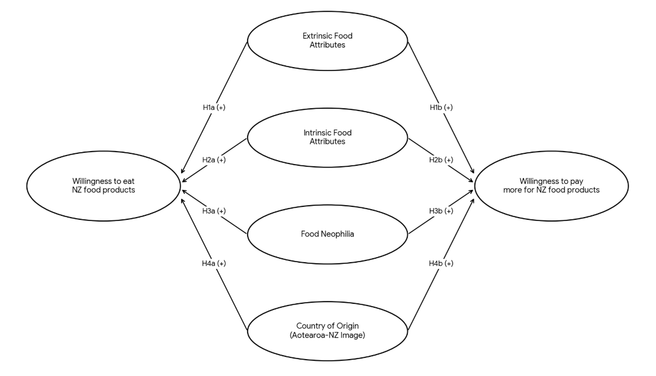
Conceptual Model
Caso & Vecchio, 2022
Korčok et al., 2024
Wortmann et al., 2023
Henderson et al., 2025
Figure 1: Conceptual Model, Source: Authors (2026)
4

Slide 6
Sample Demographics & PLS-SEM Analysis
6

Slide 7
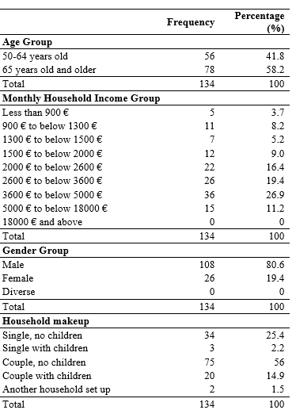
Table 1: Sample Demographics
Source: Authors (2026)
5

Slide 8
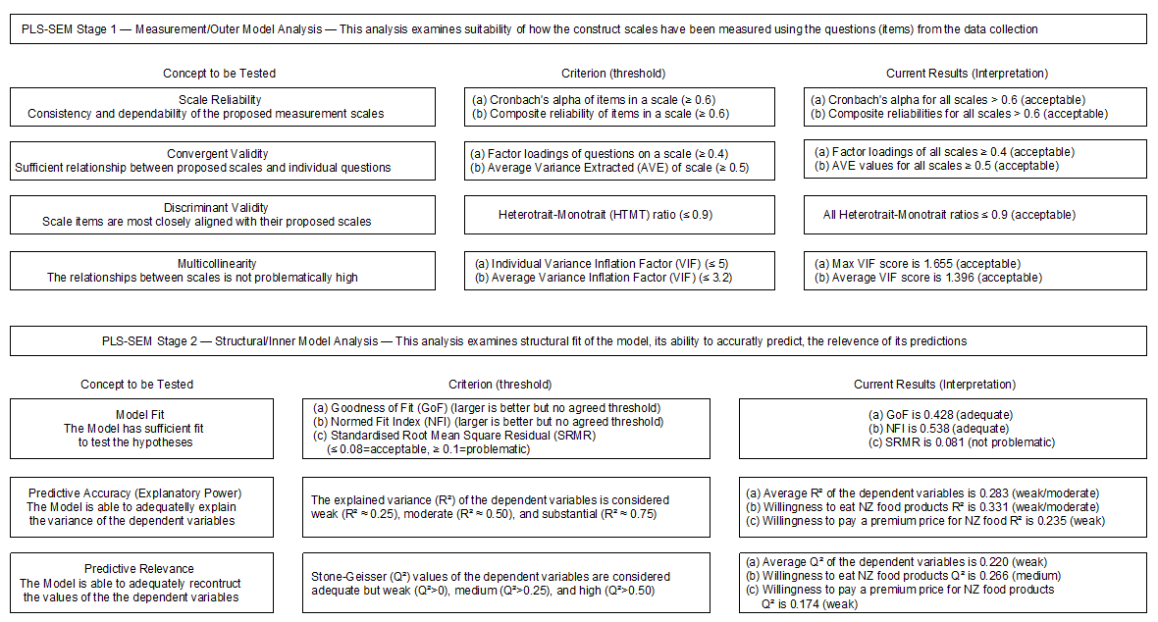
Figure 2: PLS-SEM Analysis; Source: Authors (2026) based on Hair (2022)

Slide 9
Results, Discussion & Conclusion
6

Slide 10
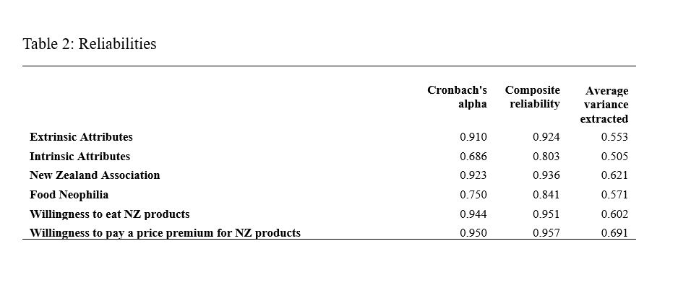
10

Slide 11
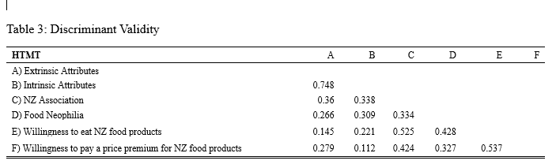
Source: Authors (2026)
10

Slide 12
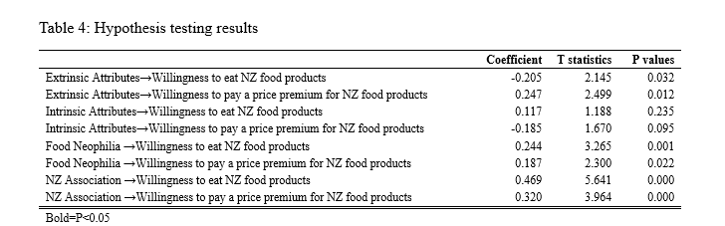
Source: Authors (2026)
10

Slide 13
Conclusion
Provides insights for food marketers targeting quality-conscious older German consumers.
Capitalize on Aotearoa-New Zealand's narrative of purity, unique taste, and reliable premium quality.
Balances Packaging Design: Suggests using premium, easy-to-use materials while offering sample sizes to lower perceived consumer risk.
Addresses a neglected demographic in existing export literature despite the limitation of a small sample size.
Future Research: Recommends future studies use point-of-sale sampling, real choice experiments, and cross-generational cohort comparisons
10

Slide 14
References
Barković Bojanić, I., Erceg, A., & Damoska Sekuloska, J. (2024). Silver entrepreneurship: A golden opportunity for ageing society. Economics and Business Review, 10(1), 153-178. https://doi.org/10.18559/ebr.2024.1.1068
Bundesministerium für Familie, Senioren, Frauen und Jugend- BMFSFJ. (2020). Older people in Germany and the EU: Report. Online available at https://www.bmfsfj.de [Accessed 10/11/2025].
Bundesministerium für Wirtschaft und Klimaschutz- BMWK. (2022). Jahreswirtschaftsbericht 2022. Online available at https://www.bmwk.de [Accessed 10/11/2025].
Caso, G., & Vecchio, R. (2022). Factors influencing independent older adults (un)healthy food choices: A systematic review and research agenda. Food Research International, 158, 1-16. https://doi.org/10.1016/j.foodres.2022.111476
European Commission. (2021). The silver economy: Final report. Online available at https://publications.europa.eu/resource/cellar/2dca9276-3ec5-11e8-b5fe-01aa75ed71a1.0002.01/DOC_1 [Accessed 08/11/2025].
Hair, J. E., Hult, G. T., Ringle, C. M., & Sarstedt, M. A. (2022). Primer on partial least squares structural equation modeling (PLS-SEM). (3rd ed.). Sage Publications.
Hair, J. F., Risher, J. J., Sarstedt, M., & Ringle, C. M. (2019). When to use and how to report the results of PLS-SEM. European Business Review, 31(1), 2–24. https://doi.org/10.1108/EBR-11-2018-0203
Henderson, K., Kemper, J., Lang, B., Conroy, D., & Frethey-Bentham, C. (2025). Threat or opportunity? A stakeholder perspective on country-of-origin brand and promoting gene edited foods. Journal of Strategic Marketing, 1–18. https://doi.org/10.1080/0965254x.2025.2519004
Korčok, M., Veverka, M., Nakonechna, K., Škrípová, S., & Vietoris, V. (2024). Factors Influencing Elderly Consumers’ Preferences for Edible Gels: Insights from Slovakia. Gels, 10(10), 1-17. https://doi.org/10.3390/gels10100610
Vatsa, P., & Renwick, A. (2024). Food prices in New Zealand: implications for feeding people
better. Journal of the Royal Society of New Zealand, 55(6), 2305–2318. https://doi.org/10.1080/03036758.2024.2368788
Wortmann, H. R., Gisch, U. A., Bergmann, M. M., & Warschburger, P. (2023). Exploring the Longitudinal Stability of Food Neophilia and Dietary Quality and Their Prospective Relationship in Older Adults: A Cross-Lagged Panel Analysis. Nutrients, 15(5), 1-16. https://doi.org/10.3390/nu15051248
11
Notes:
Say nothing

Slide 15
Thank you for your time
12

